Slide 1
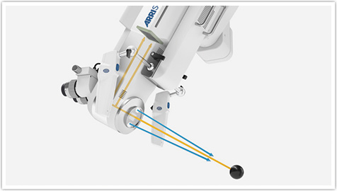
Digital surgical microscope for stereoscopic viewing
Surgeon sees a binocular high quality 3D image
Multispectral illumination
Raw camera data

Slide 2
Full HD 3D screening monitor for co-observer in the operating room
Full HD 3D viewing for outside the operating room
Full HD 3D recording – see http://www.arrimedical.com/videos.html
Why can’t you record directly from the sensors in the ARRIScope?
“At the heart of our work lies ALEXA. This camera system, developed by ARRI, is considered all over the world to be the gold standard in motion picture imaging. In order to record microscopic images during operations, an ALEXA camera can be mounted to the documentation port of a surgical microscope with the help of a customized adapter.”
http://www.arrimedical.com/arri_surgical_imaging.html

Slide 3
Question: Is NIR light dangerous for tissue? Do we need NIR light or just NIR sensor?
“The novel, multispectral LED illumination system of the ARRISCOPE delivers very bright and highly uniform illumination, optimized for representation on a video monitor. The cold light, without any UV or IR components, protects the patient by avoiding heat impairment.”

Slide 4
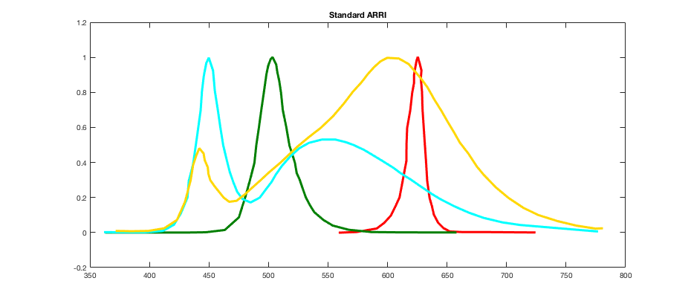
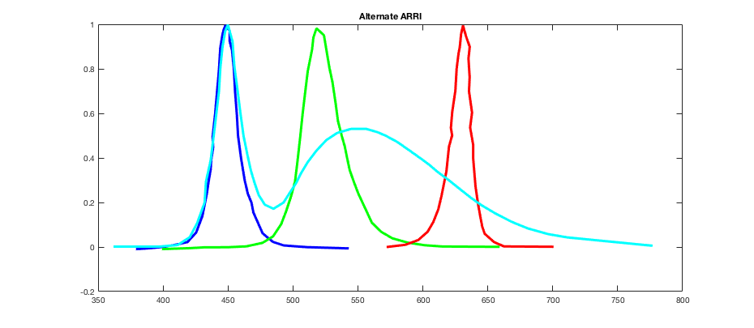

Slide 5
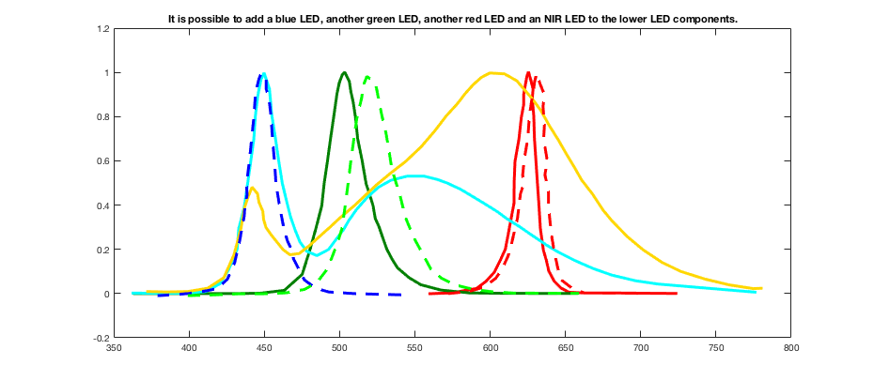
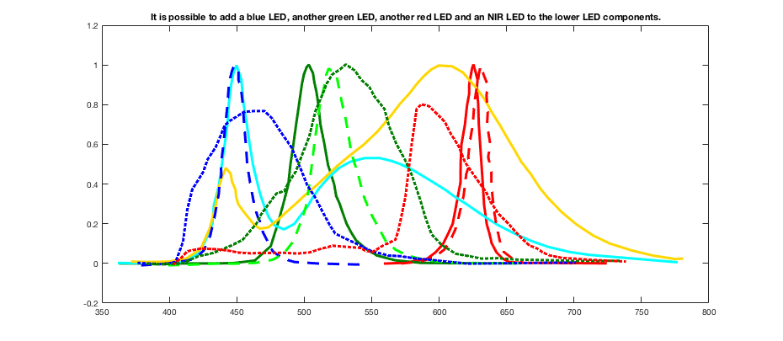

Slide 6
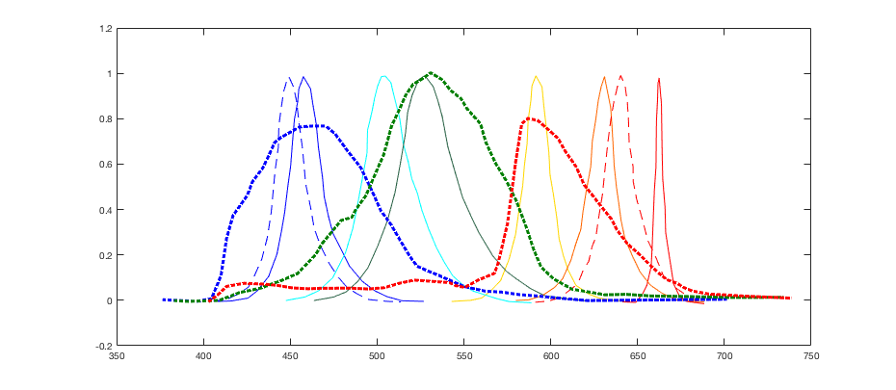
If we could redesign
Luxeon LEDs and ARII Sensors

Slide 7
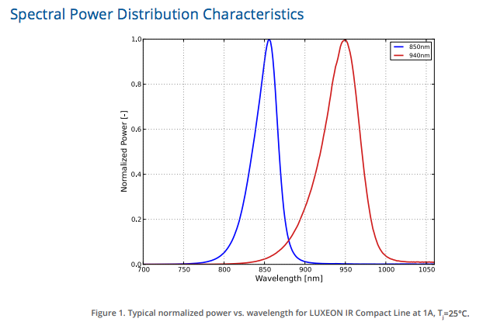

Slide 8
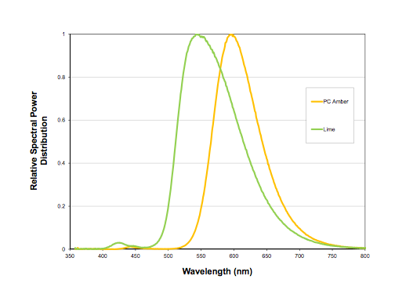

Slide 9
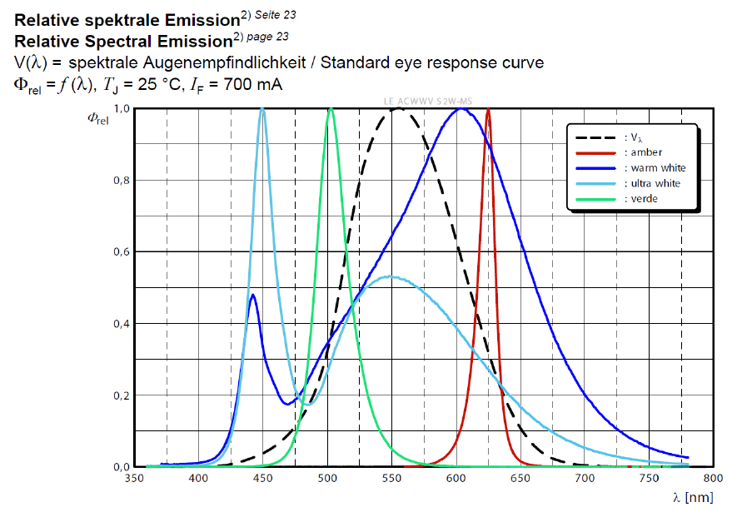

Slide 10
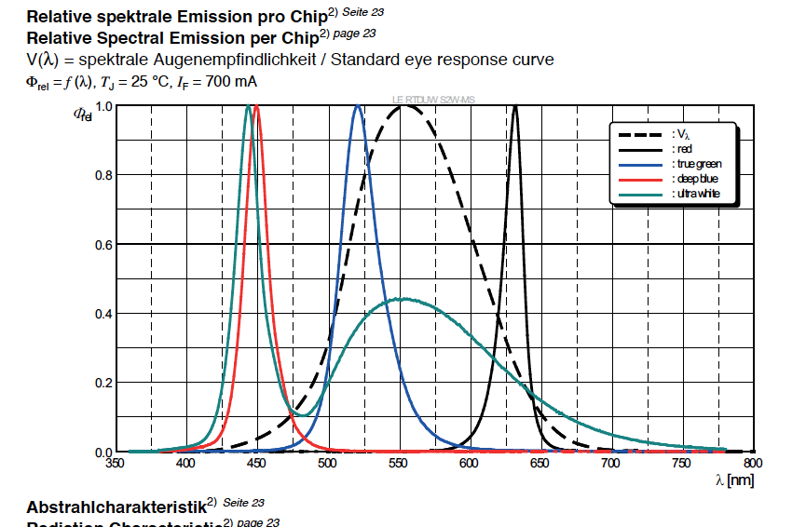

Slide 11
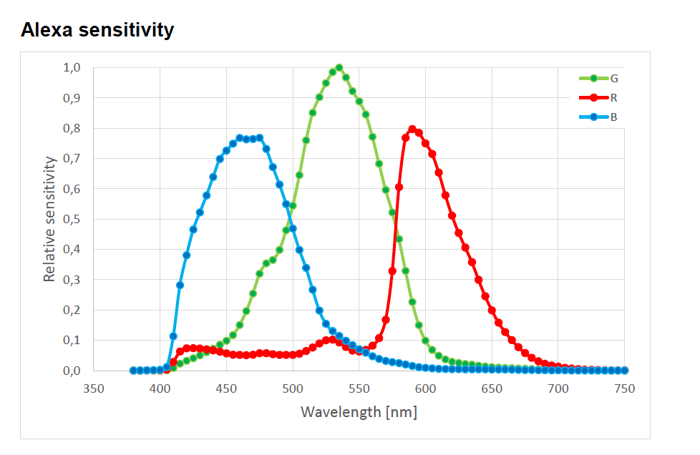

Slide 12
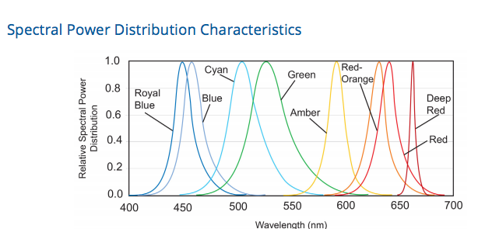

Slide 13
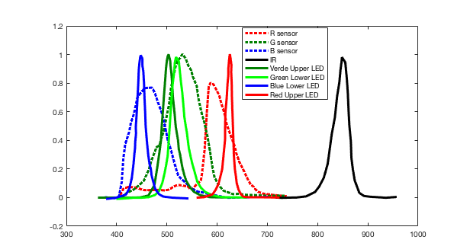
Possible easy configuration by modifying “Lower LEDs”

Slide 14
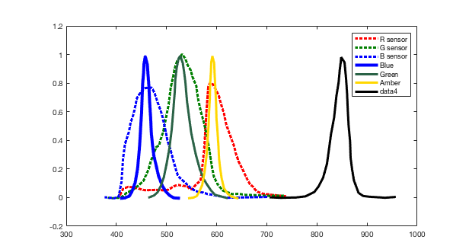
If I could pick the LEDs I wanted

Slide 15
ARRISCOPE LAB* Fully digital 3D Microscope for lab use
Presentation 09/ 2017
*) NOT FOR HUMAN USE

Slide 16
SPECIFICATIONS OF VIDEO SYSTEM
Image Sensor 3392 x 2200 Pixel
Output resolution Full HD 1920 x 1080 Pixel
Dynamic range 14+ stops
Frame rate 60 Hz
Digital video output Glass Fiber (DVI)
Video recording medium 2 x 2,5‘‘ – SSD
Capacity of video storage 512 Gigabyte
Video recording format ProRes 4:2:2 HQ / H.264
Recording format single frames TIFF 16 bit
Monitor 24‘‘ LCD 3D monitor 1920 x 1080 Pixel
HD binoculars OLED displays 1920 x 1080 Pixel
Technical data subject to change without further notice. Data refer to ARRISCOPE 1.0. Mai 19, 2017 © ARRI Medical/2017
Arnold & Richter Cine Technik GmbH & Co. Betriebs KG · Türkenstrasse 89 · 80799 Munich · Tel +49 89 3809-0 · www.arrimedical.com

Slide 17
OPTICAL CHARACTERISTICS
Specification of Video Systems
Working distance 250mm
Max. visual field at 250mm working distance 90 mm x 50 mm
Min. visual field at 250mm working distance 16 mm x 9 mm
Illumination High-performance LED cold light source (without IR/UV), Multi spectral, 4 channels
Stereo base 21 mm
Zoom factor 6 x
Binocular inclination angle -50° to +90°
Diopter adjustment +/- 5D
Technical data subject to change without further notice. Data refer to ARRISCOPE 1.0. Mai 19, 2017 © ARRI Medical/2017
Arnold & Richter Cine Technik GmbH & Co. Betriebs KG · Türkenstrasse 89 · 80799 Munich · Tel +49 89 3809-0 · www.arrimedical.com

Slide 18
OPTICAL CHARACTERISTICS
Specification of Video Systems
Working distance 250mm
Max. visual field at 250mm working distance 90 mm x 50 mm
Min. visual field at 250mm working distance 16 mm x 9 mm
Illumination High-performance LED cold light source (without IR/UV), Multi spectral
Stereo base 21 mm
Zoom factor 6 x
Binocular inclination angle -50° to +90°
Diopter adjustment +/- 5D
STAND: GENERAL DATA (desktop mounting on request)
Maximum arm reach 1500 mm
Braking system Pneumatic
Compressing air tank 10 l / @ 6 bar
Release actions according to max. tank load approx. 200 x
Footprint 857 mm x 760 mm
Total weight 370 kg
Total weight including transport box 554 kg
Maximum length of monitor arm 800 mm
Technical data subject to change without further notice. Data refer to ARRISCOPE 1.0. Mai 19, 2017 © ARRI Medical/2017
Arnold & Richter Cine Technik GmbH & Co. Betriebs KG · Türkenstrasse 89 · 80799 Munich · Tel +49 89 3809-0 · www.arrimedical.com

Slide 19
ELECTRICAL SPECIFICATIONS (country specific versions on request)
Power consumption 1300 W
Input ~ 230 V (US Version will be different)
Maximum current at 230 V 6 A
Frequency 50 Hz
SOFTWARE FUNCTIONS
Image mesurements (geometric)
Special enhancements through look files
Side by side view / Real image and DICOM
Technical data subject to change without further notice. Data refer to ARRISCOPE 1.0. Mai 19, 2017 © ARRI Medical/2017
Arnold & Richter Cine Technik GmbH & Co. Betriebs KG · Türkenstrasse 89 · 80799 Munich · Tel +49 89 3809-0 · www.arrimedical.com

Slide 20
Options
Additional Working distances:
210mm Max. visual field at 210 mm working distance 78 mm x 43 mm
Min. visual field at 210 mm working distance 14 mm x 8 mm
300mm: Max. visual field at 300 mm working distance 107 mm x 60 mm
Min. visual field at 300 mm working distance 19 mm x 11 mm
430mm
Max. visual field at 430 mm working distance 150 mm x 85 mm
Min. visual field at 430 mm working distance 24 mm x 13,5 mm

Slide 21
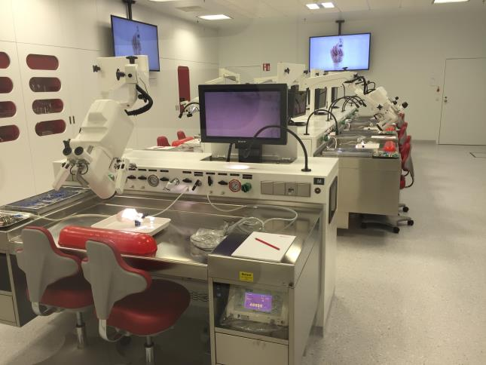
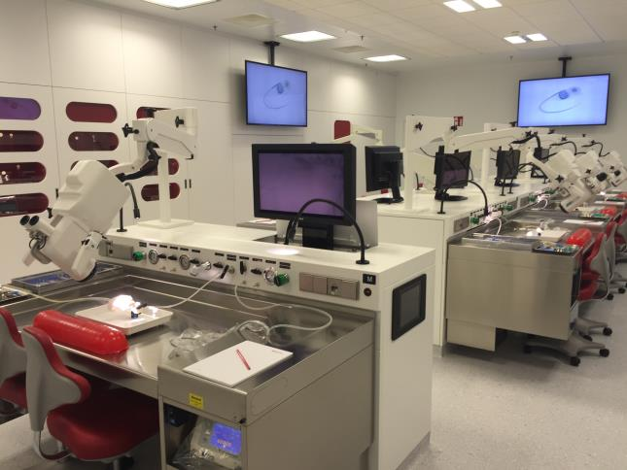
ARRISCOPE LAB Installation*
MED-EL Training Lab Innsbruck, Austria
*) ARRISCOPE LAB, Desktop mounted Version

Slide 22
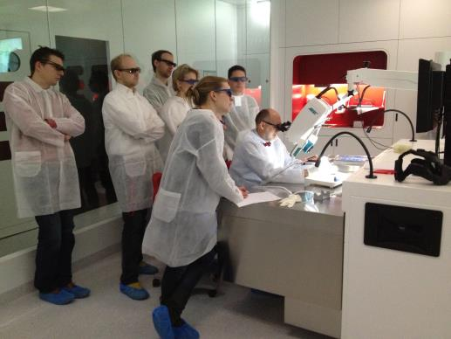
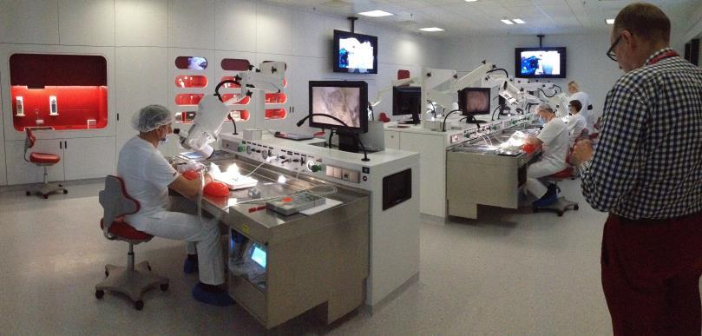
ARRISCOPE LAB Installation*
Participants with identical 3D view in real time than the surgeon
Instructor can observe each participants workstation during preparation in 3D
*) ARRISCOPE LAB, Desktop mounted Version

